Slide 1
IDS 462 Lecture 9
A Very Brief Lecture on Time Series
Using Time Series on the S&P 500

Slide 2
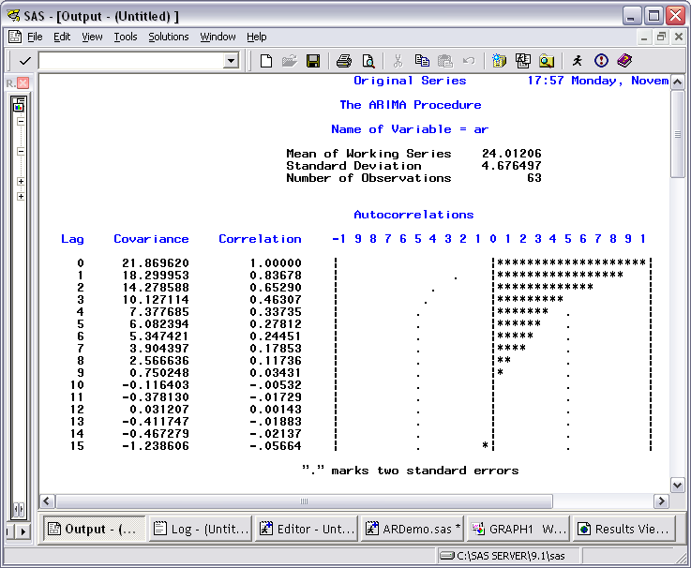
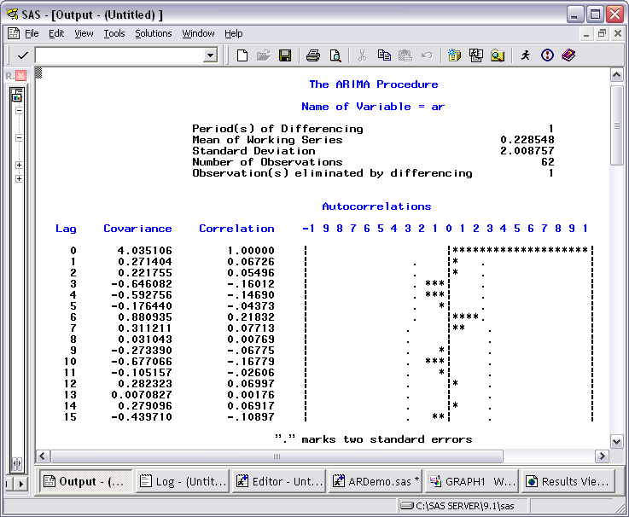
Time Series– In BRIEF
To build a model for a single series of data…
First, stabilize the series by differencing
Not stable
AC’s slowly decrease
Stable after differencing
AC(0)=1, but then cut-off

Slide 3
What Kind of Model?
After stabilizing, we want to fit an AR or MA model (or a combination of both)
Recall that an AR model has the form
  Y_{t}=C+Φ₁Y_{t-1}+ Φ₂Y_{t-2}+…a_{t} and is a function of past values
And an MA models has the form
  Y_{t}=a_{t}-θ₁a_{t-1}- θ₂a_{t-2}…and is a function of past shocks
Recall that we are modeling for Y and a_{t} is a random number (or shock)

Slide 4
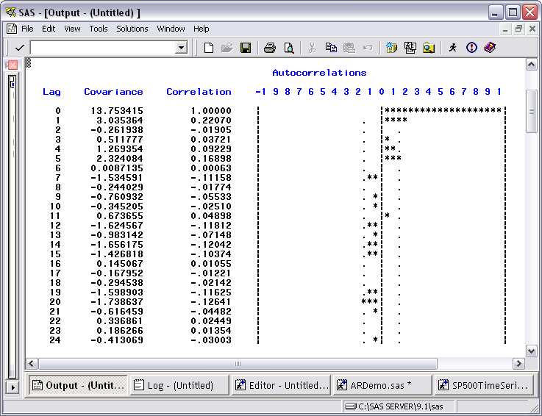
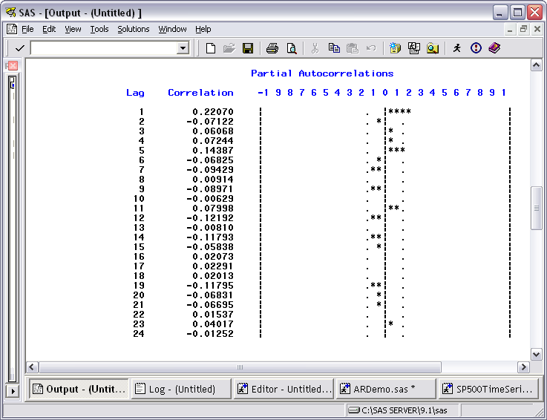
Tentative Model Identification
After stabilizing, a significant spike at lag n in the auto correlations suggests that the model needs a MA terms at lag n
Similarly, a spike in the PACF suggest an AR term at that lag
The S&P 500 data show a spike on both, so either an AR(1) model or an MA(1) could be fit. I chose an MA(1).

Slide 5
Key Model Terms in SAS
In SAS you identify the amount of differencing with the () after the dependent variable on the identify line
The MA term with the q= and any AR terms with p=
  The number after the = gives the number of lags back for the model term
proc arima data=&dsn;
identify var=Y(1) scan stationarity=(adf=4);
estimate q=1 outest=est;
run;

Slide 6
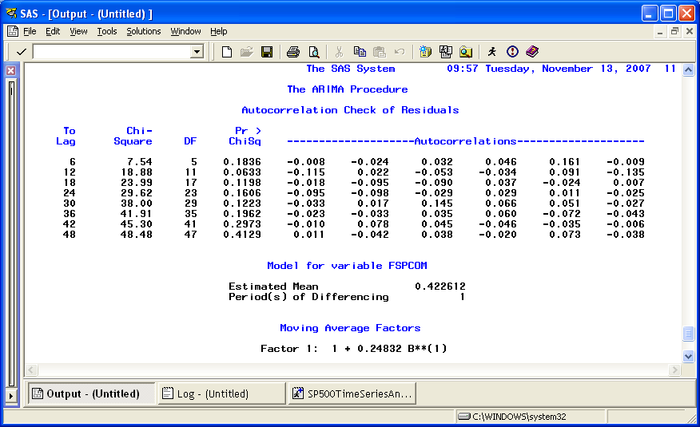
Residual Check
After modeling, the chi-square test for correlation in the residuals should be non-significant
There is an exception here, but the model is worse if we add an additional term

Slide 7
Step Ahead Forecasting
One step ahead forecasting means that you take all the data up to a point and use it to estimate the value for the next period
This is what is done in the SAS program for consecutive months for the price of the S&P composite index

Slide 8
Very Basic Investment Strategies
If you think a stock will go up, you buy it now and sell it later
  This is called going ‘long’
  So pay full price for the investment now, sell it at the later price
If you think something will go down then you go ‘short’
  Effectively, sell the shares today and buy them back later
  You do this by borrowing the shares from someone who has them, selling those and then buying back later and returning them to the party that you borrowed them from
  To do this, you must put up half the cost of the investment as collateral

Slide 9
Apply To TS Model for S&P
So, if the forecast for next month is higher than the price for this month then you go long
If the forecast for next month is lower than the price for this month then go short

Slide 10
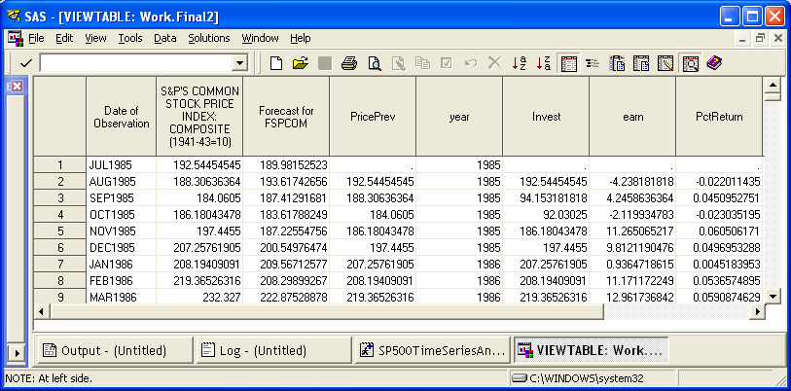
Investment Decisions/Results
The dataset final2 contains the results of the predictions and investments– let’s talk this over

Slide 11
Overall Return
The proc means at the end of the program gives the annual average return of using the time series strategy
We need something to compare this to, so we compare it to Buy & Hold
  This strategy buys the S&P 500 at the beginning of the period and does not alter it until the end of the entire time period
Which one is better?
What role does the standard deviation play?

Slide 12
Sharp’s Ratio
For an investment strategy we prefer
  Higher average returns
  Lower standard deviation of returns
One way to measure this is the Sharp’s ratio which is defined as
  (Return from Investment-Risk Free Return)/Standard deviation of investment
This gives the incremental return (above the risk free rate) measured in units of standard deviation
If the risk free return is 5% then what is the Sharp’s ratio for these two strategies?

Slide 13
Business Memo
Your client wants to know
  Can we get a higher rate of return using a time series model strategy to predict the S&P 500
  Can we get a higher risk-adjusted rate of return
  Please describe the investment strategy

Slide 14
Technical Appendix
Give a very basic description of the time series model that you used
  Differencing
  Model form
I wouldn’t be surprised if this memo was as short as 11/2 pages

